Slide 1




MECH
Mechanical Electrical Computer Hub

Slide 2
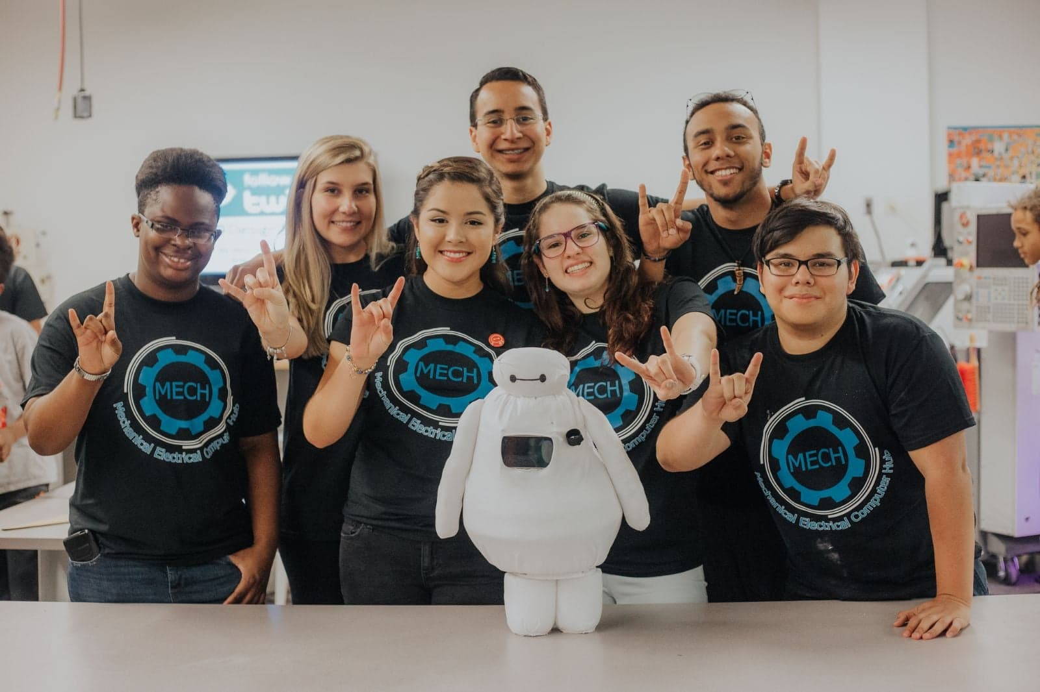
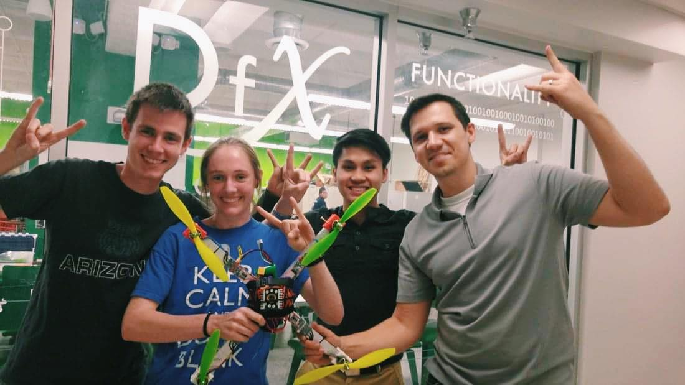
What is MECH?
Started in Fall ‘14 as USF’s first prototyping and mechatronics club, MECH is designed to encourage students of various majors to pursue projects in the area of robotics. Of course, MECH does not limit the project ideas to just robots! Open to all disciplines, we thrive on diversity, different skill levels, and, above all, creativity.

Slide 3
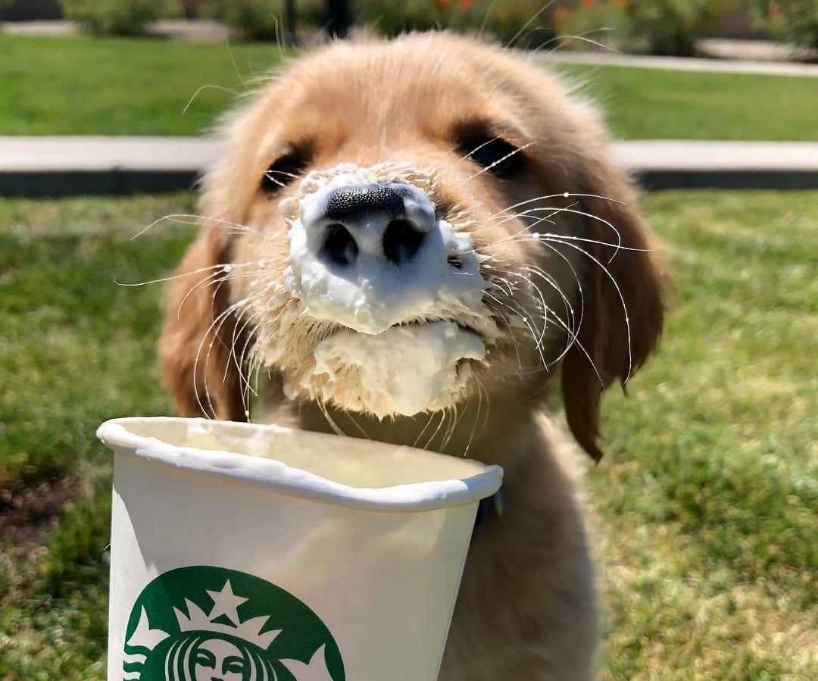

Ice, Ice, Breaker
Notes:
2 lies and a truth -- starbucks gift card $5

Slide 4
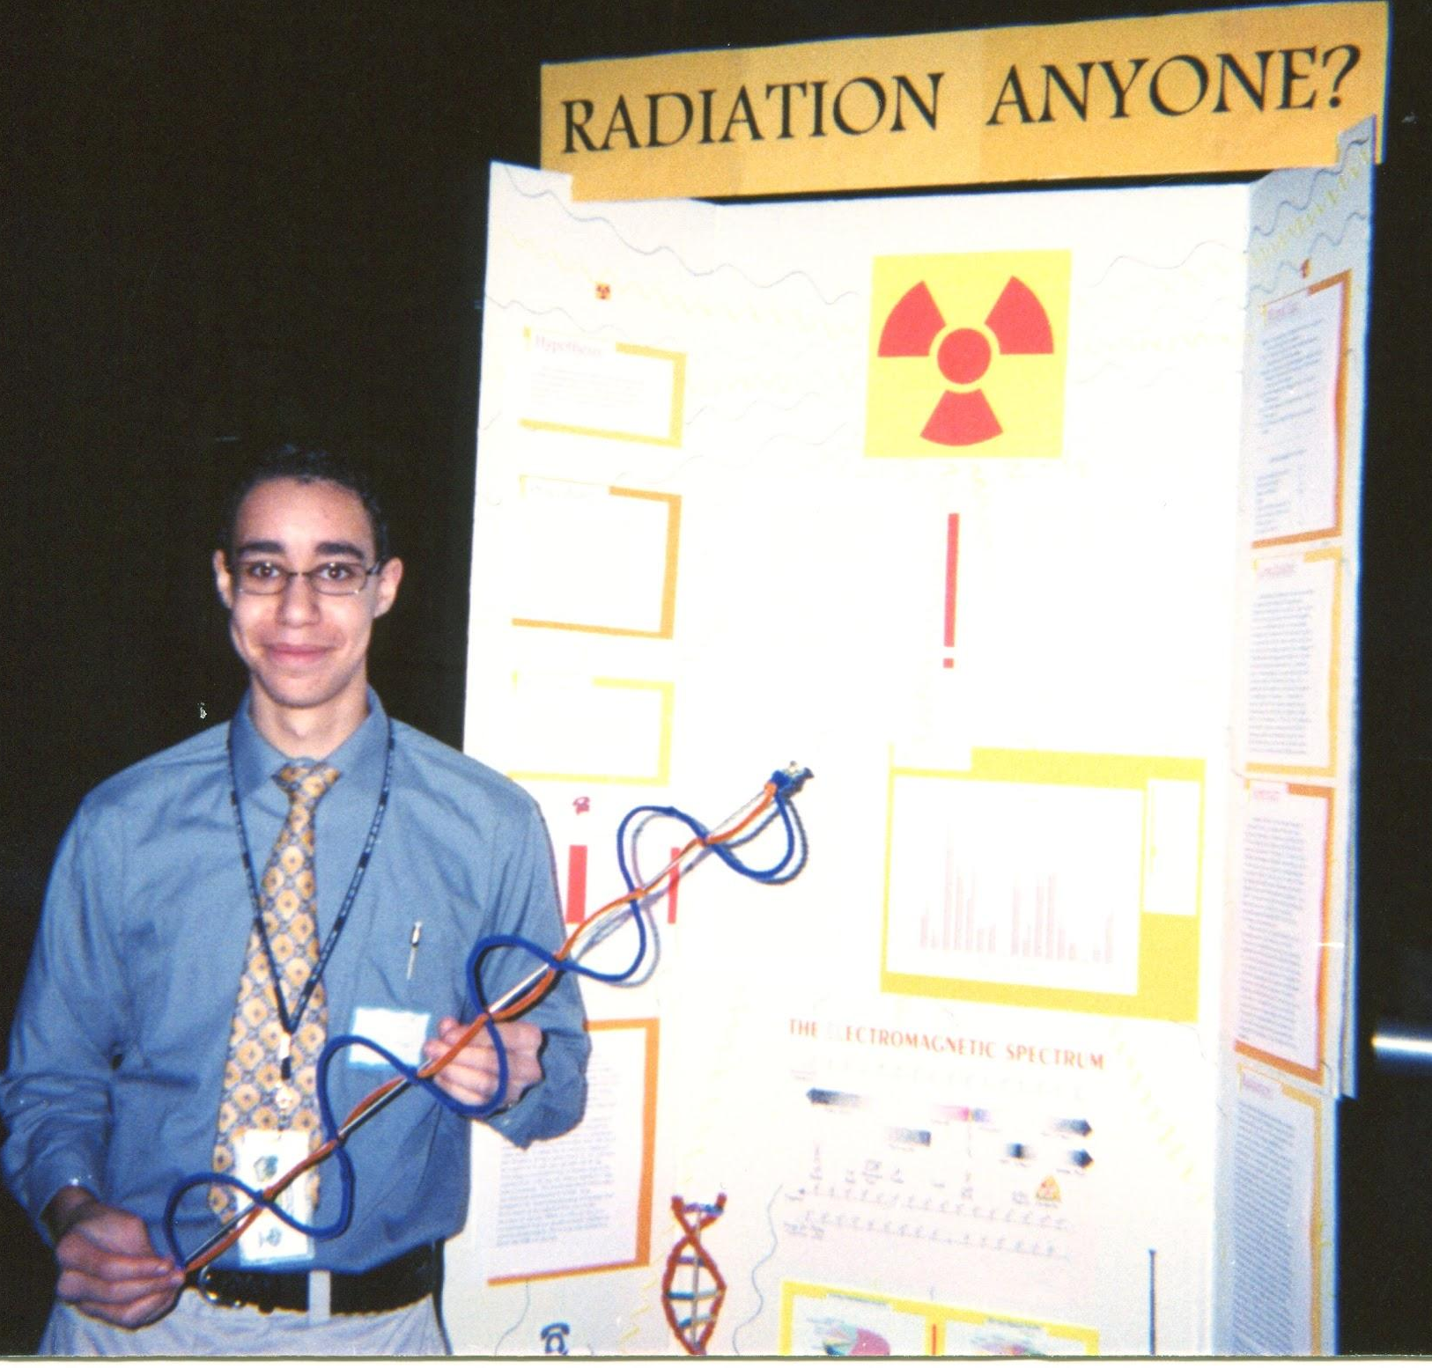
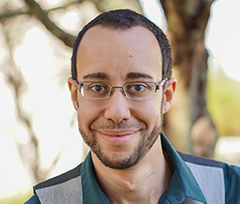
Faculty Advisor: Dr. Celestin
Major: Chemical Eng.
Profession: Anti Chemical Engineer Evangelist
Fun Fact: When I used to play piano, I once performed a solo in the jazz club in New Orleans
Email: mcelesti@usf.edu
2001
2019

Slide 5
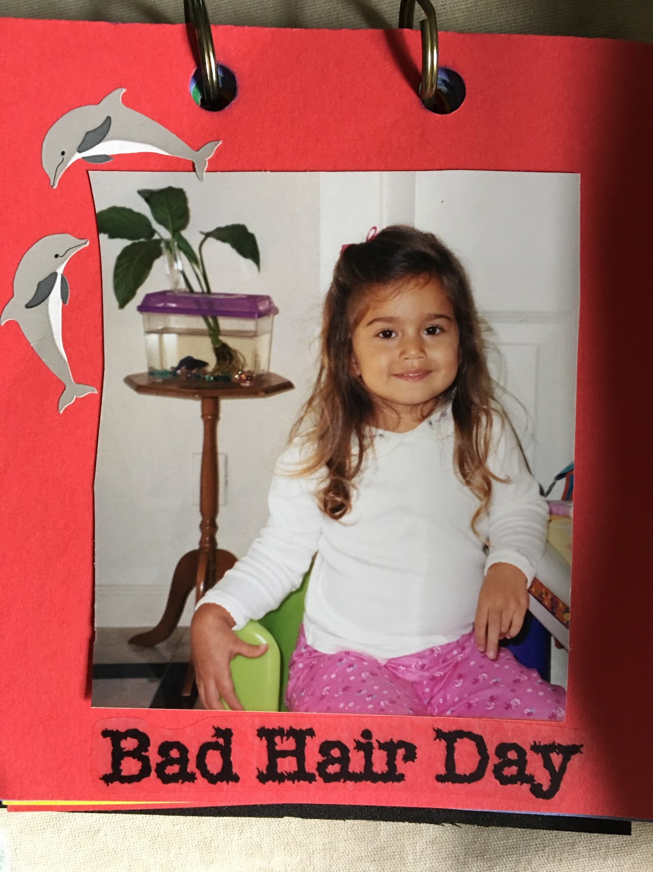
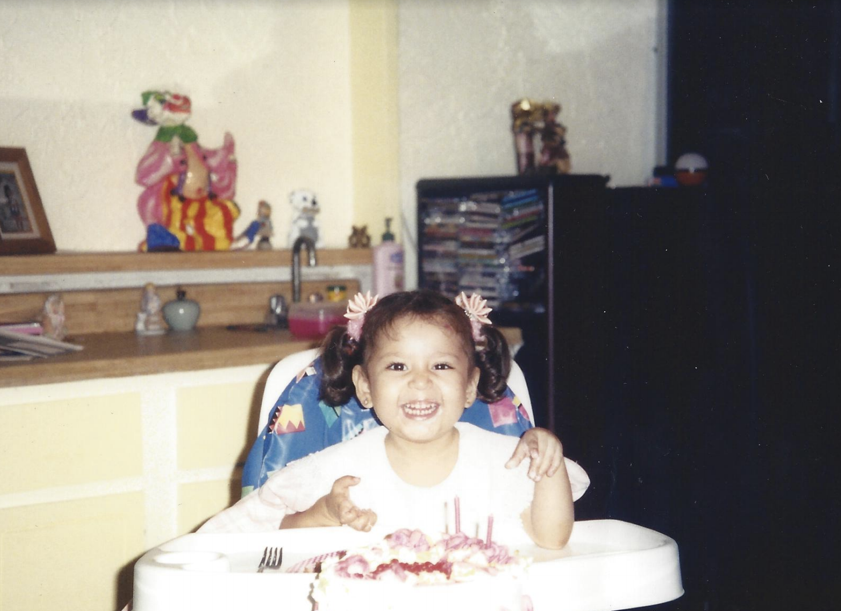
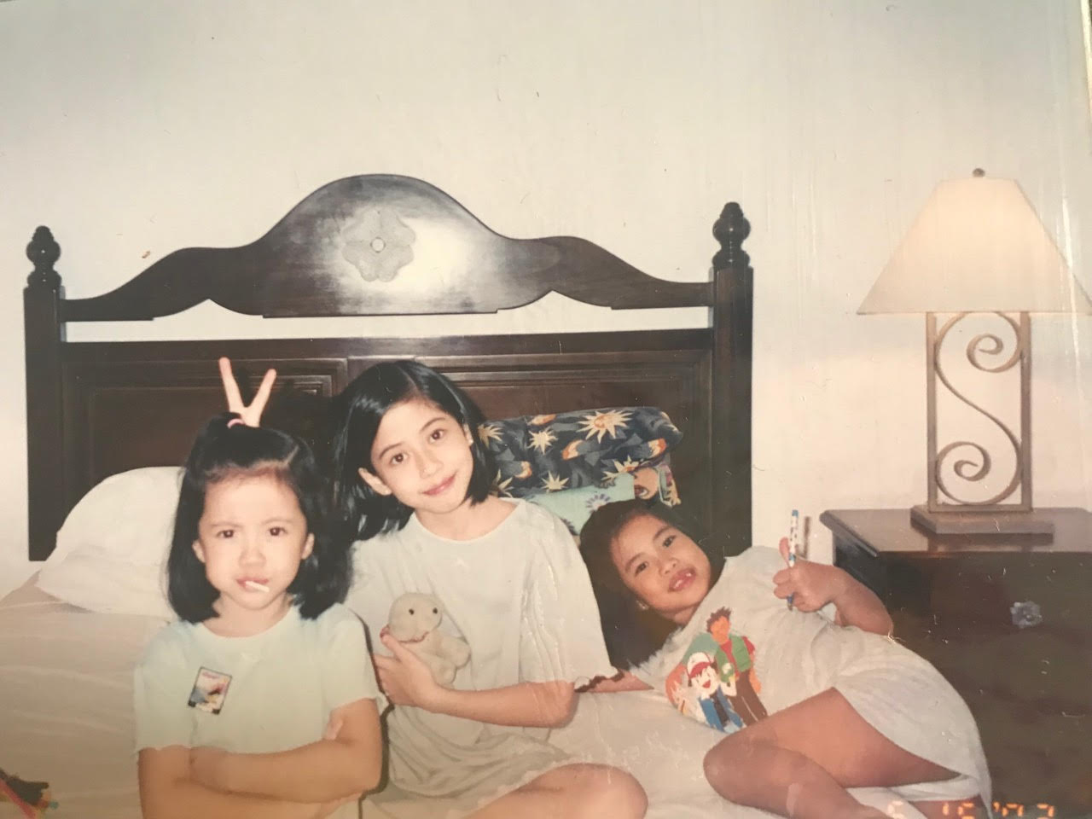
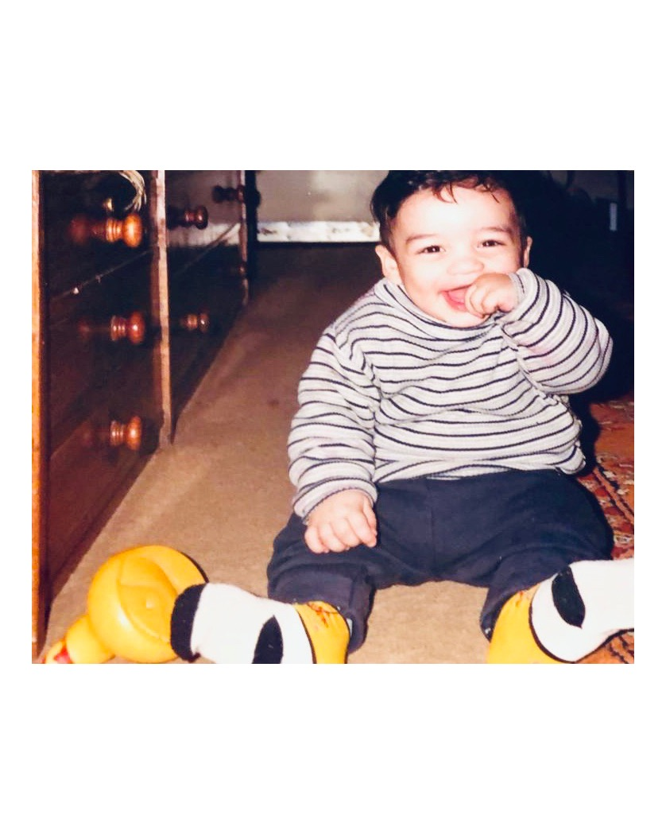

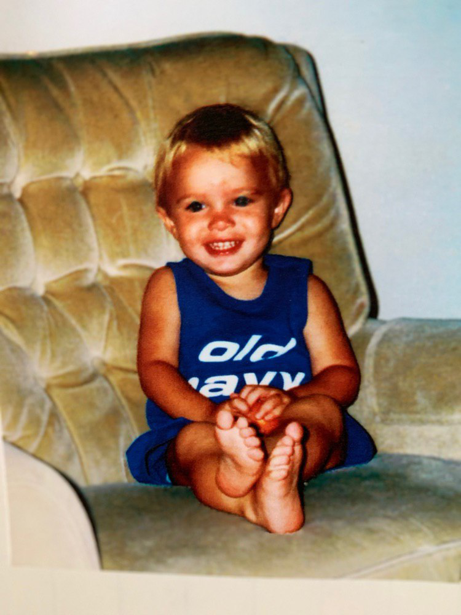
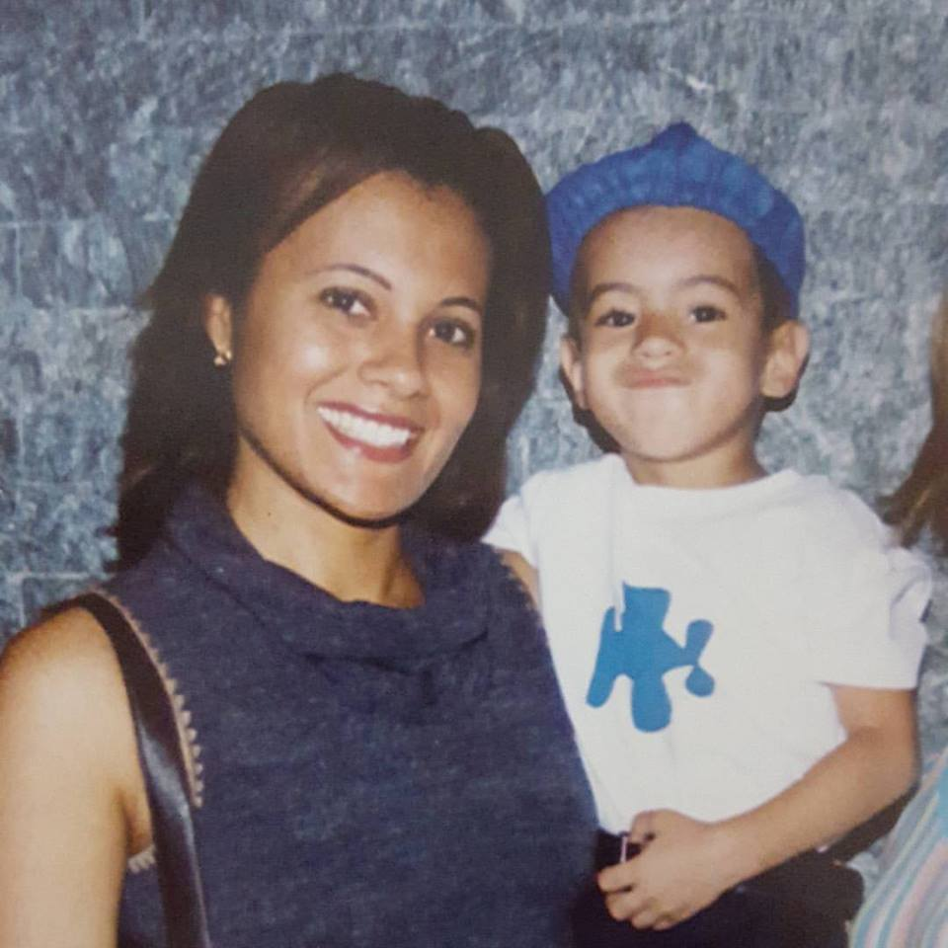
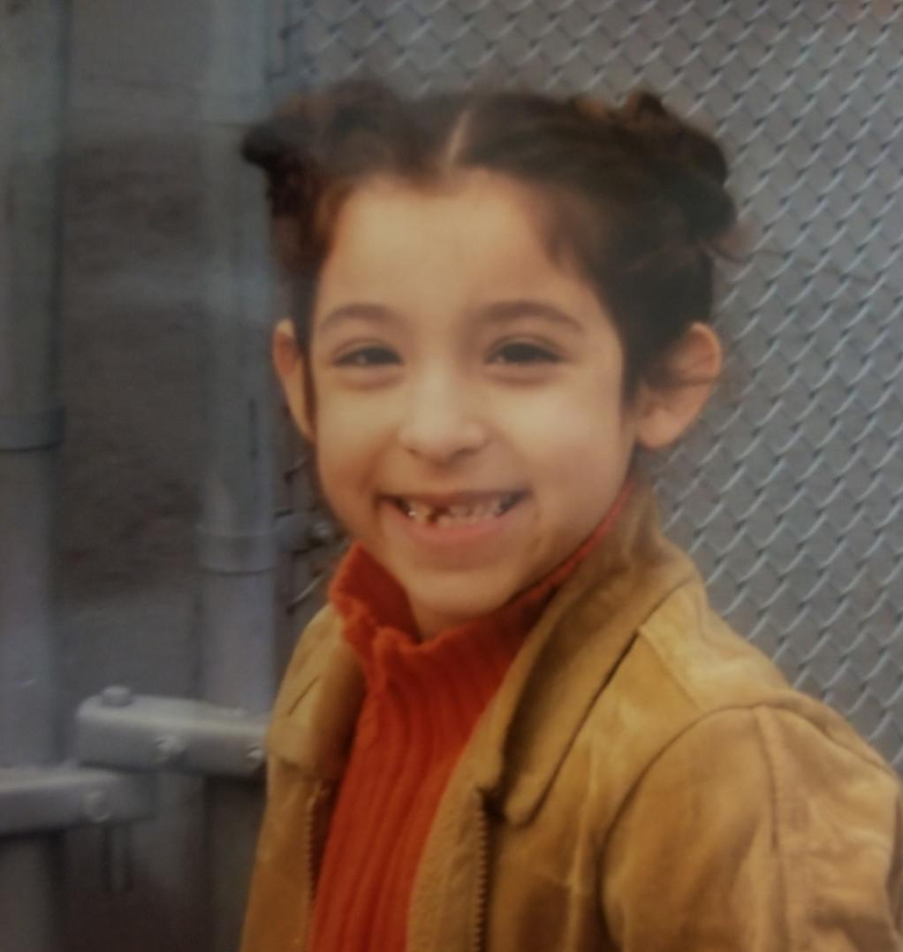
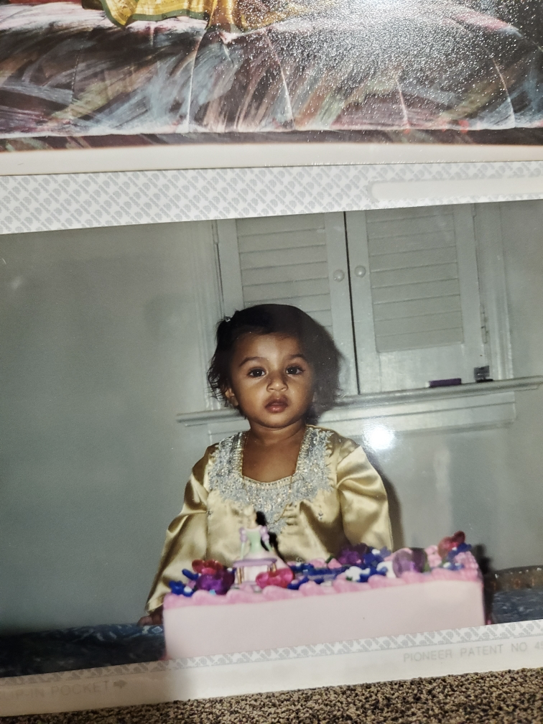
2019-2020 E-Board

Slide 6
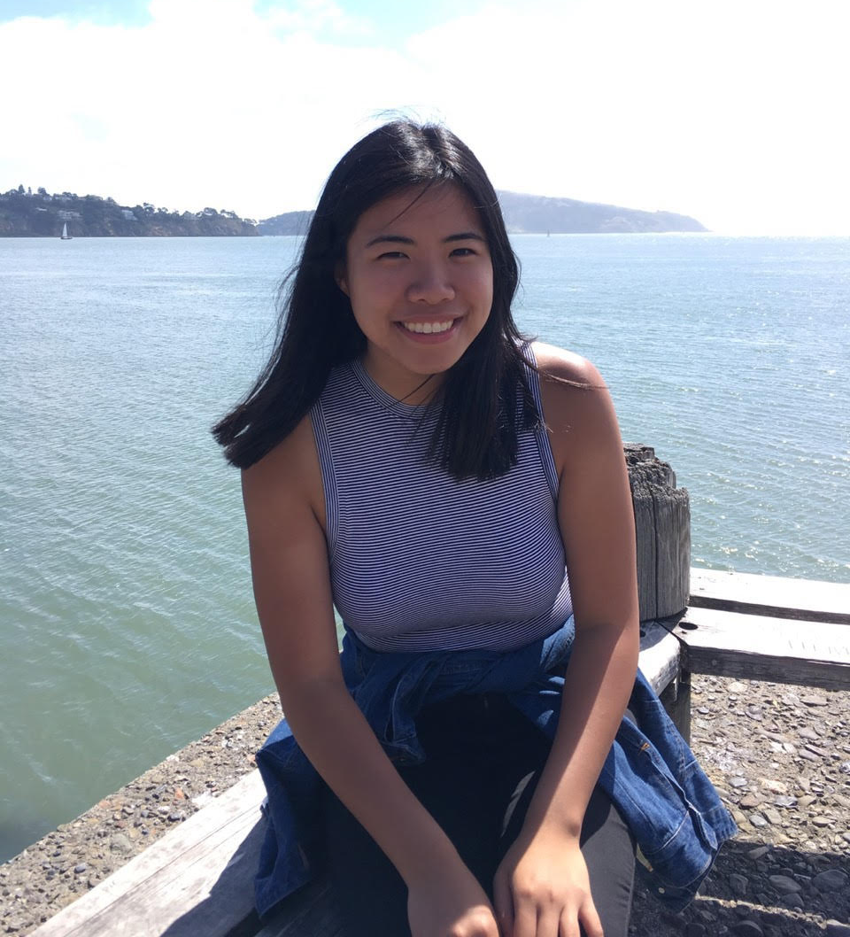
President: Victoria Carlos
Year: Senior
Major: Computer Science
Hometown: Philippines till i die… or Boca Raton, FL
Fun Fact: I swear I had ramen once a week for 14 weeks this summer 🍜🍜🍜🍜
2001
2019

Slide 7
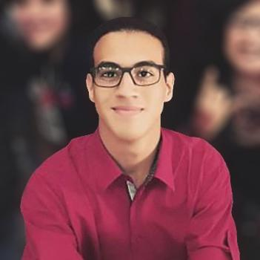
Vice President: José Ramírez
Year: Sophomore
Major: Computer Science
Hometown: Maracaibo, Venezuela
Fun Fact: I am usually mistaken for a Red Sox fan
2003
2019

Slide 8
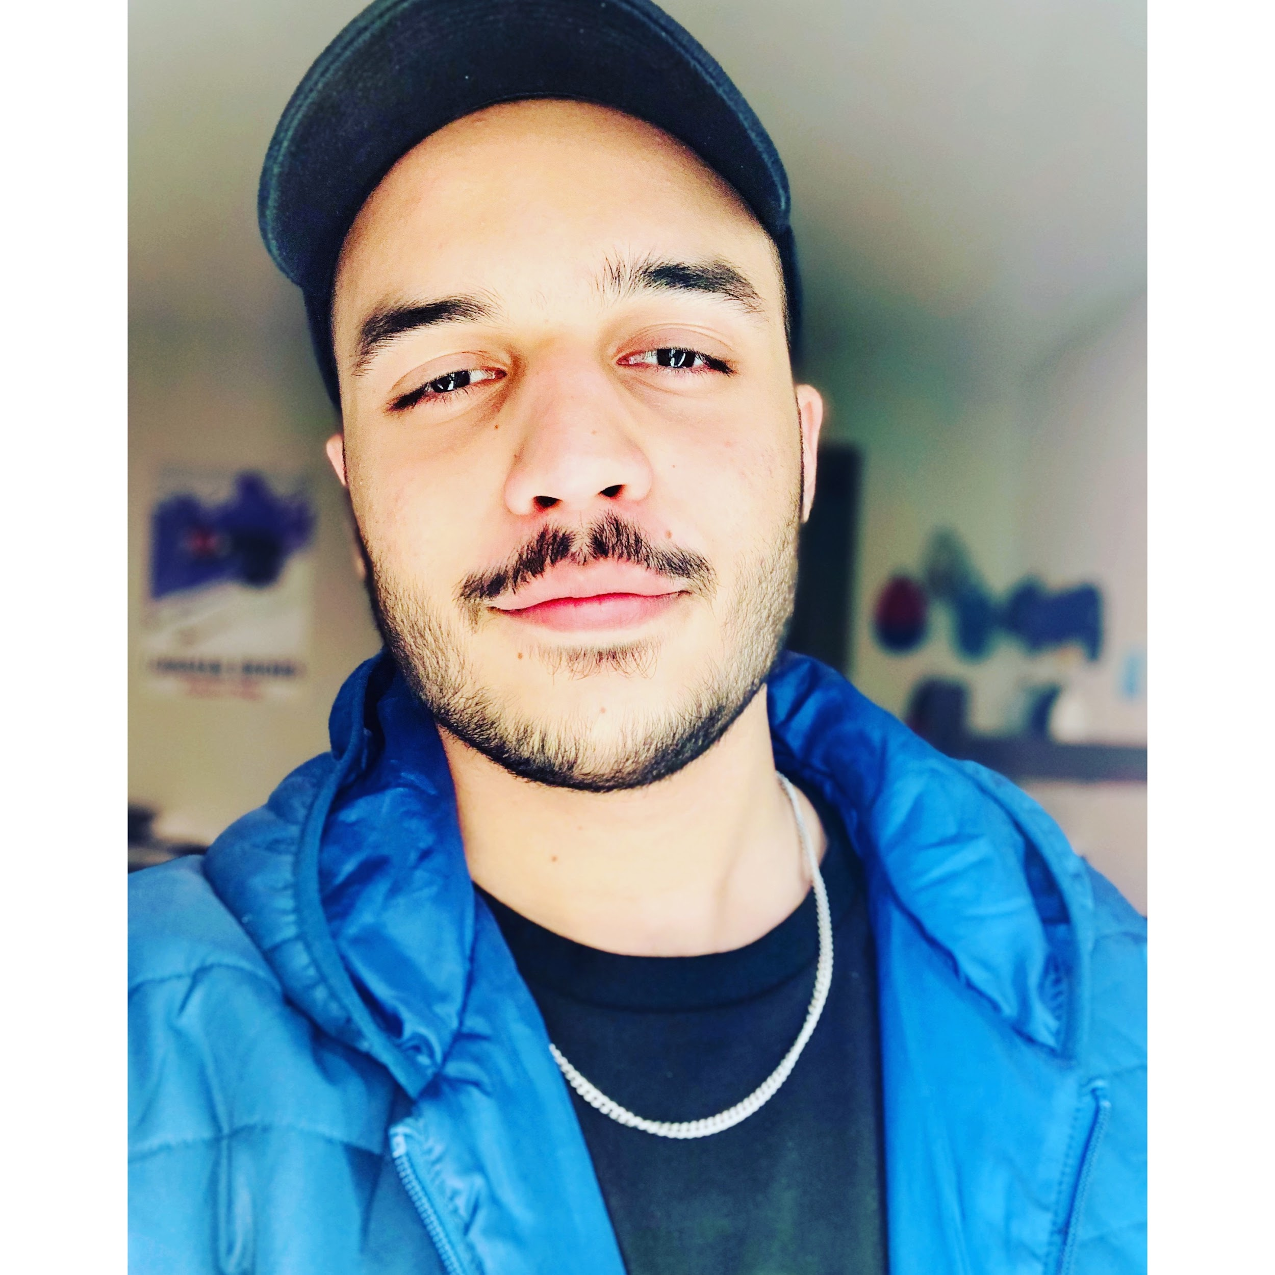
Treasurer: Haider Ali Khan
Year: Sophomore
Major: Mechanical Eng.
Hometown: Pakistan
Fun Fact: I can speak 3.5
languages!
2001
2019

Slide 9
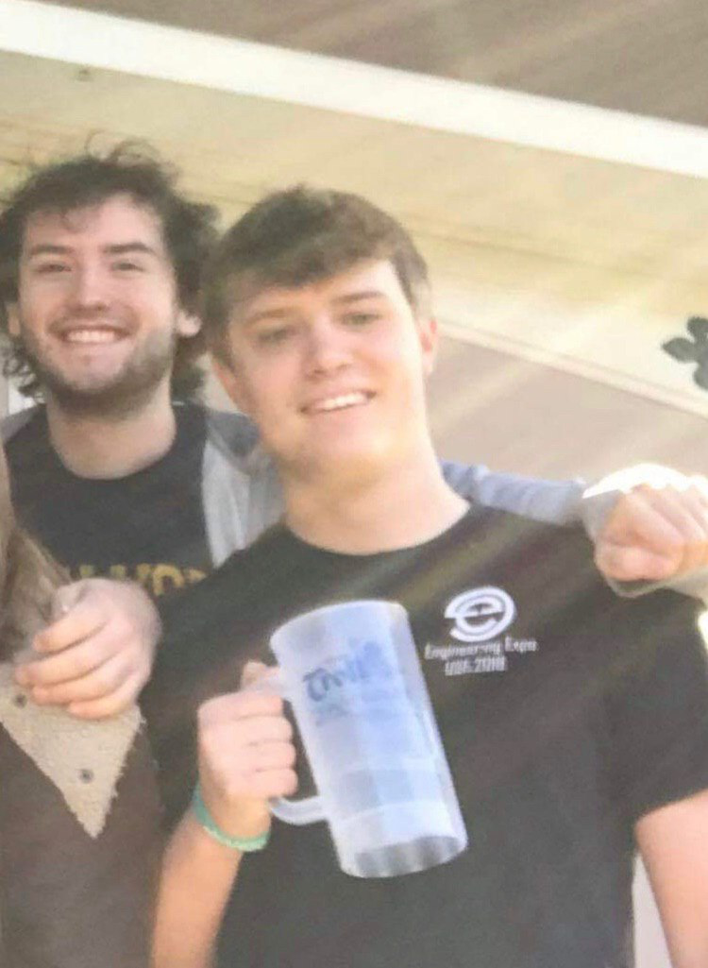
Marketing Chair: Daniel Rocchi
Year: Senior
Major: Comp Sci
Hometown: Jacksonville
Fun Fact: I broke both my arms on the same day (different accidents)
1999
2019

Slide 10
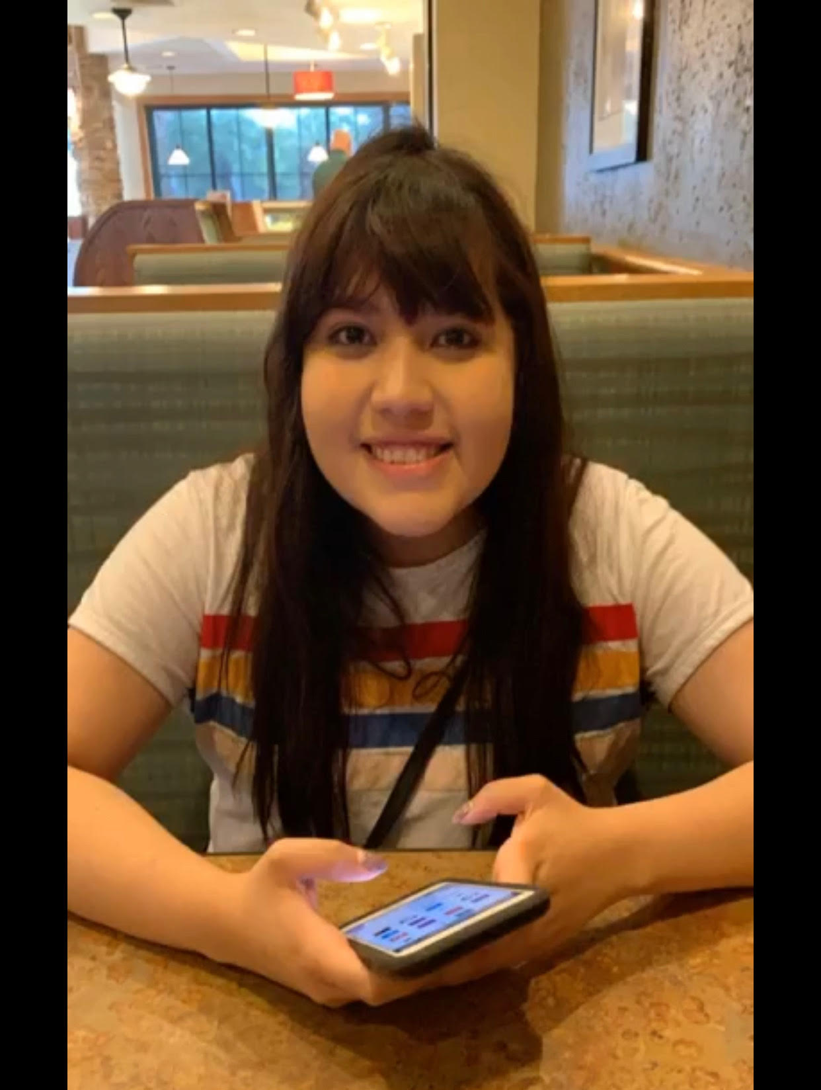
Secretary: Melissa Aguilera
Year: Sophomore
Major: Electrical Eng.
Hometown: Naples
Fun Fact: I spend all my money on coffee.
2003
2019

Slide 11
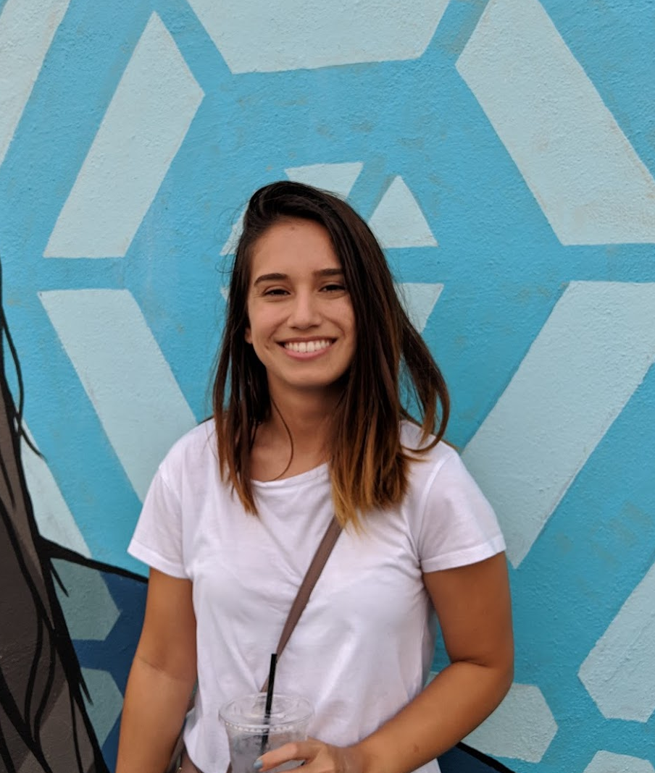
External Events Chair: Andrea Espinosa
Year: Junior?
Major: Electrical Eng.
Hometown: Daytona Beach
Fun Fact: I have an active Helicopter Underwater Escape Training Certificate
2002
2019

Slide 12
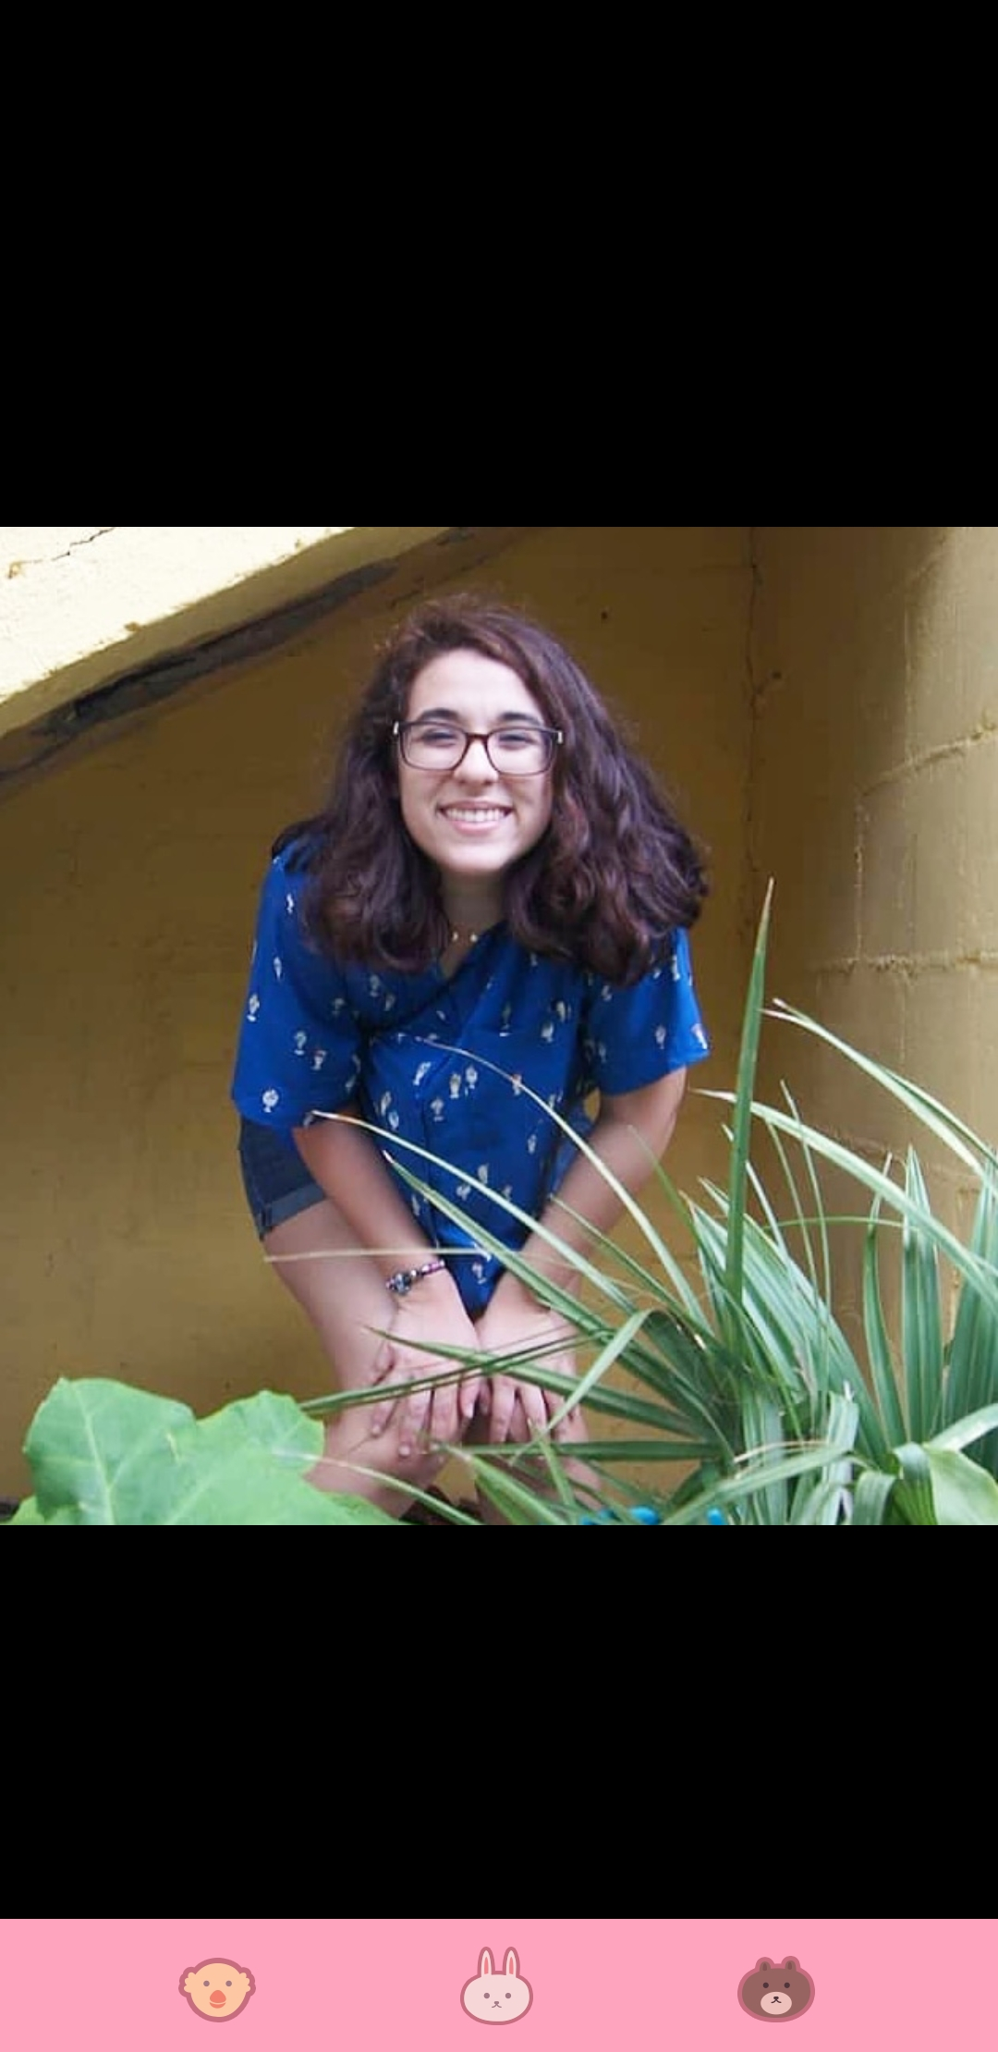
Internal Events Chair: Demi Padilla
Year: Sophomore
Major: Mechanical Eng.
Hometown: Plant City 🍓
Fun Fact: I love astronomy and aerospace!
2009
2019

Slide 13
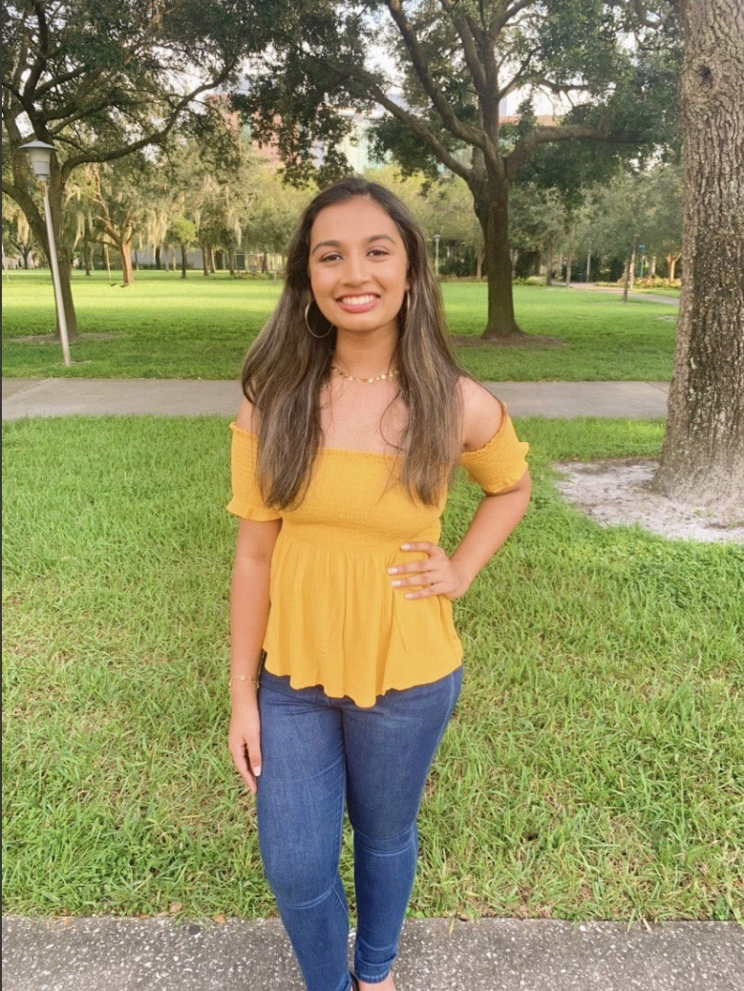
Fundraising Chair: Rushita Bachu
Year: Sophomore
Major: Computer Science
Hometown: Jacksonville
Fun Fact: I can live off of just boba
2001
2019

Slide 14
Upcoming Events
Event | Date | Time | Location
IEEE and MECH Arduino Workshop | 9/17 | 5pm | DFX
How to Build a MECH Project Part 1 of 5 | 9/20 | 3-4pm | DFX
MECH Game Night! | 9/27 | 5-last man standing pm | DFX
Chipotle Fundraiser | TBD | TBD | You guess
MECH Takes Roboticon | 10/12 | TBD | Yuengling Center
HackJam | TBD | TBD | TBD
Notes:
jose

Slide 15
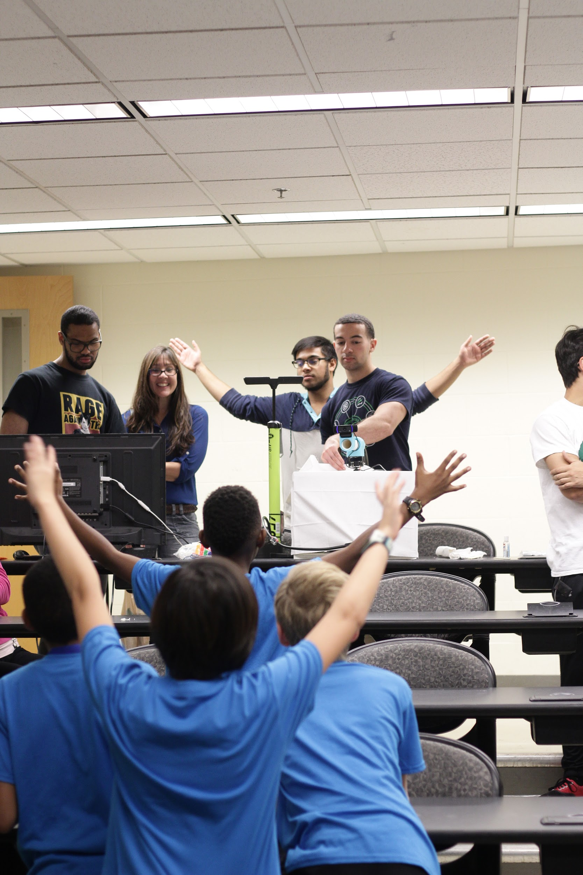
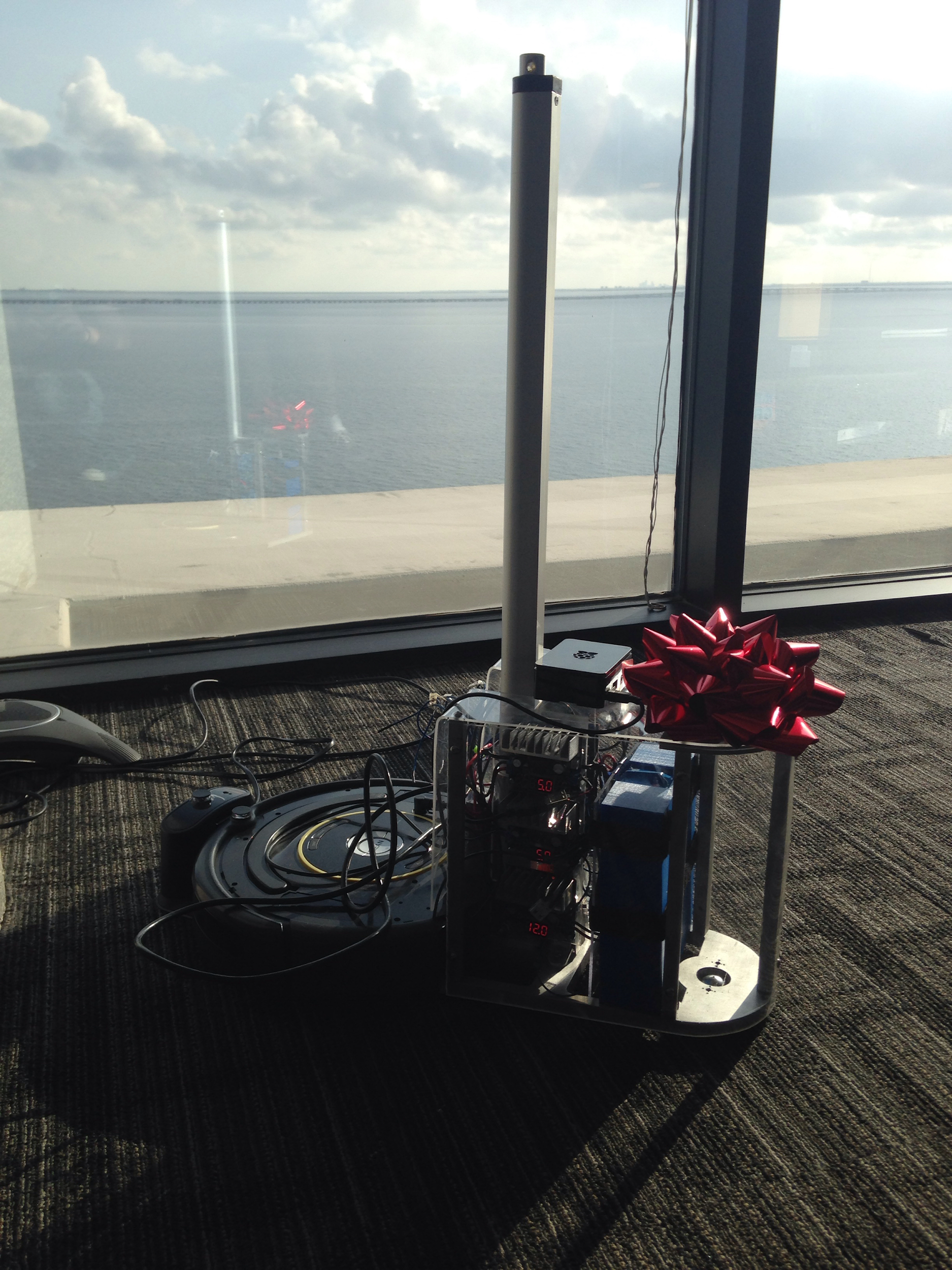
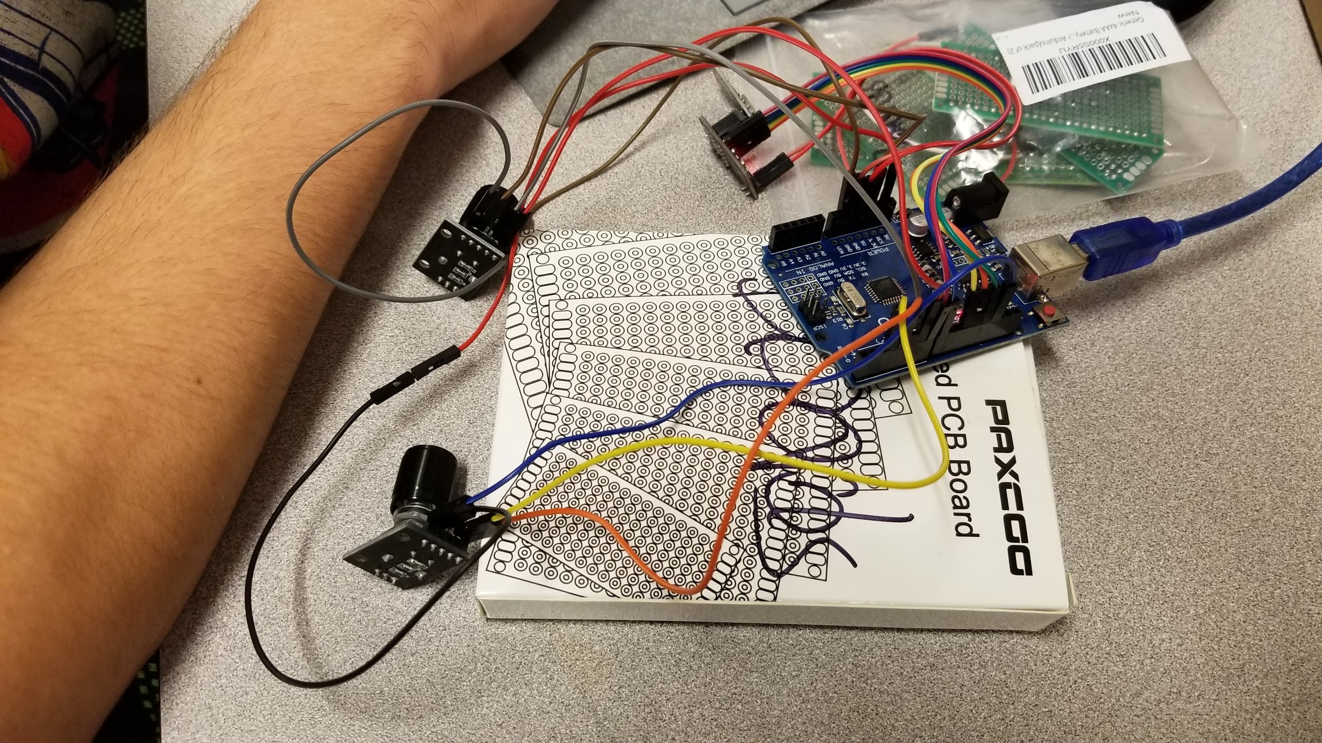
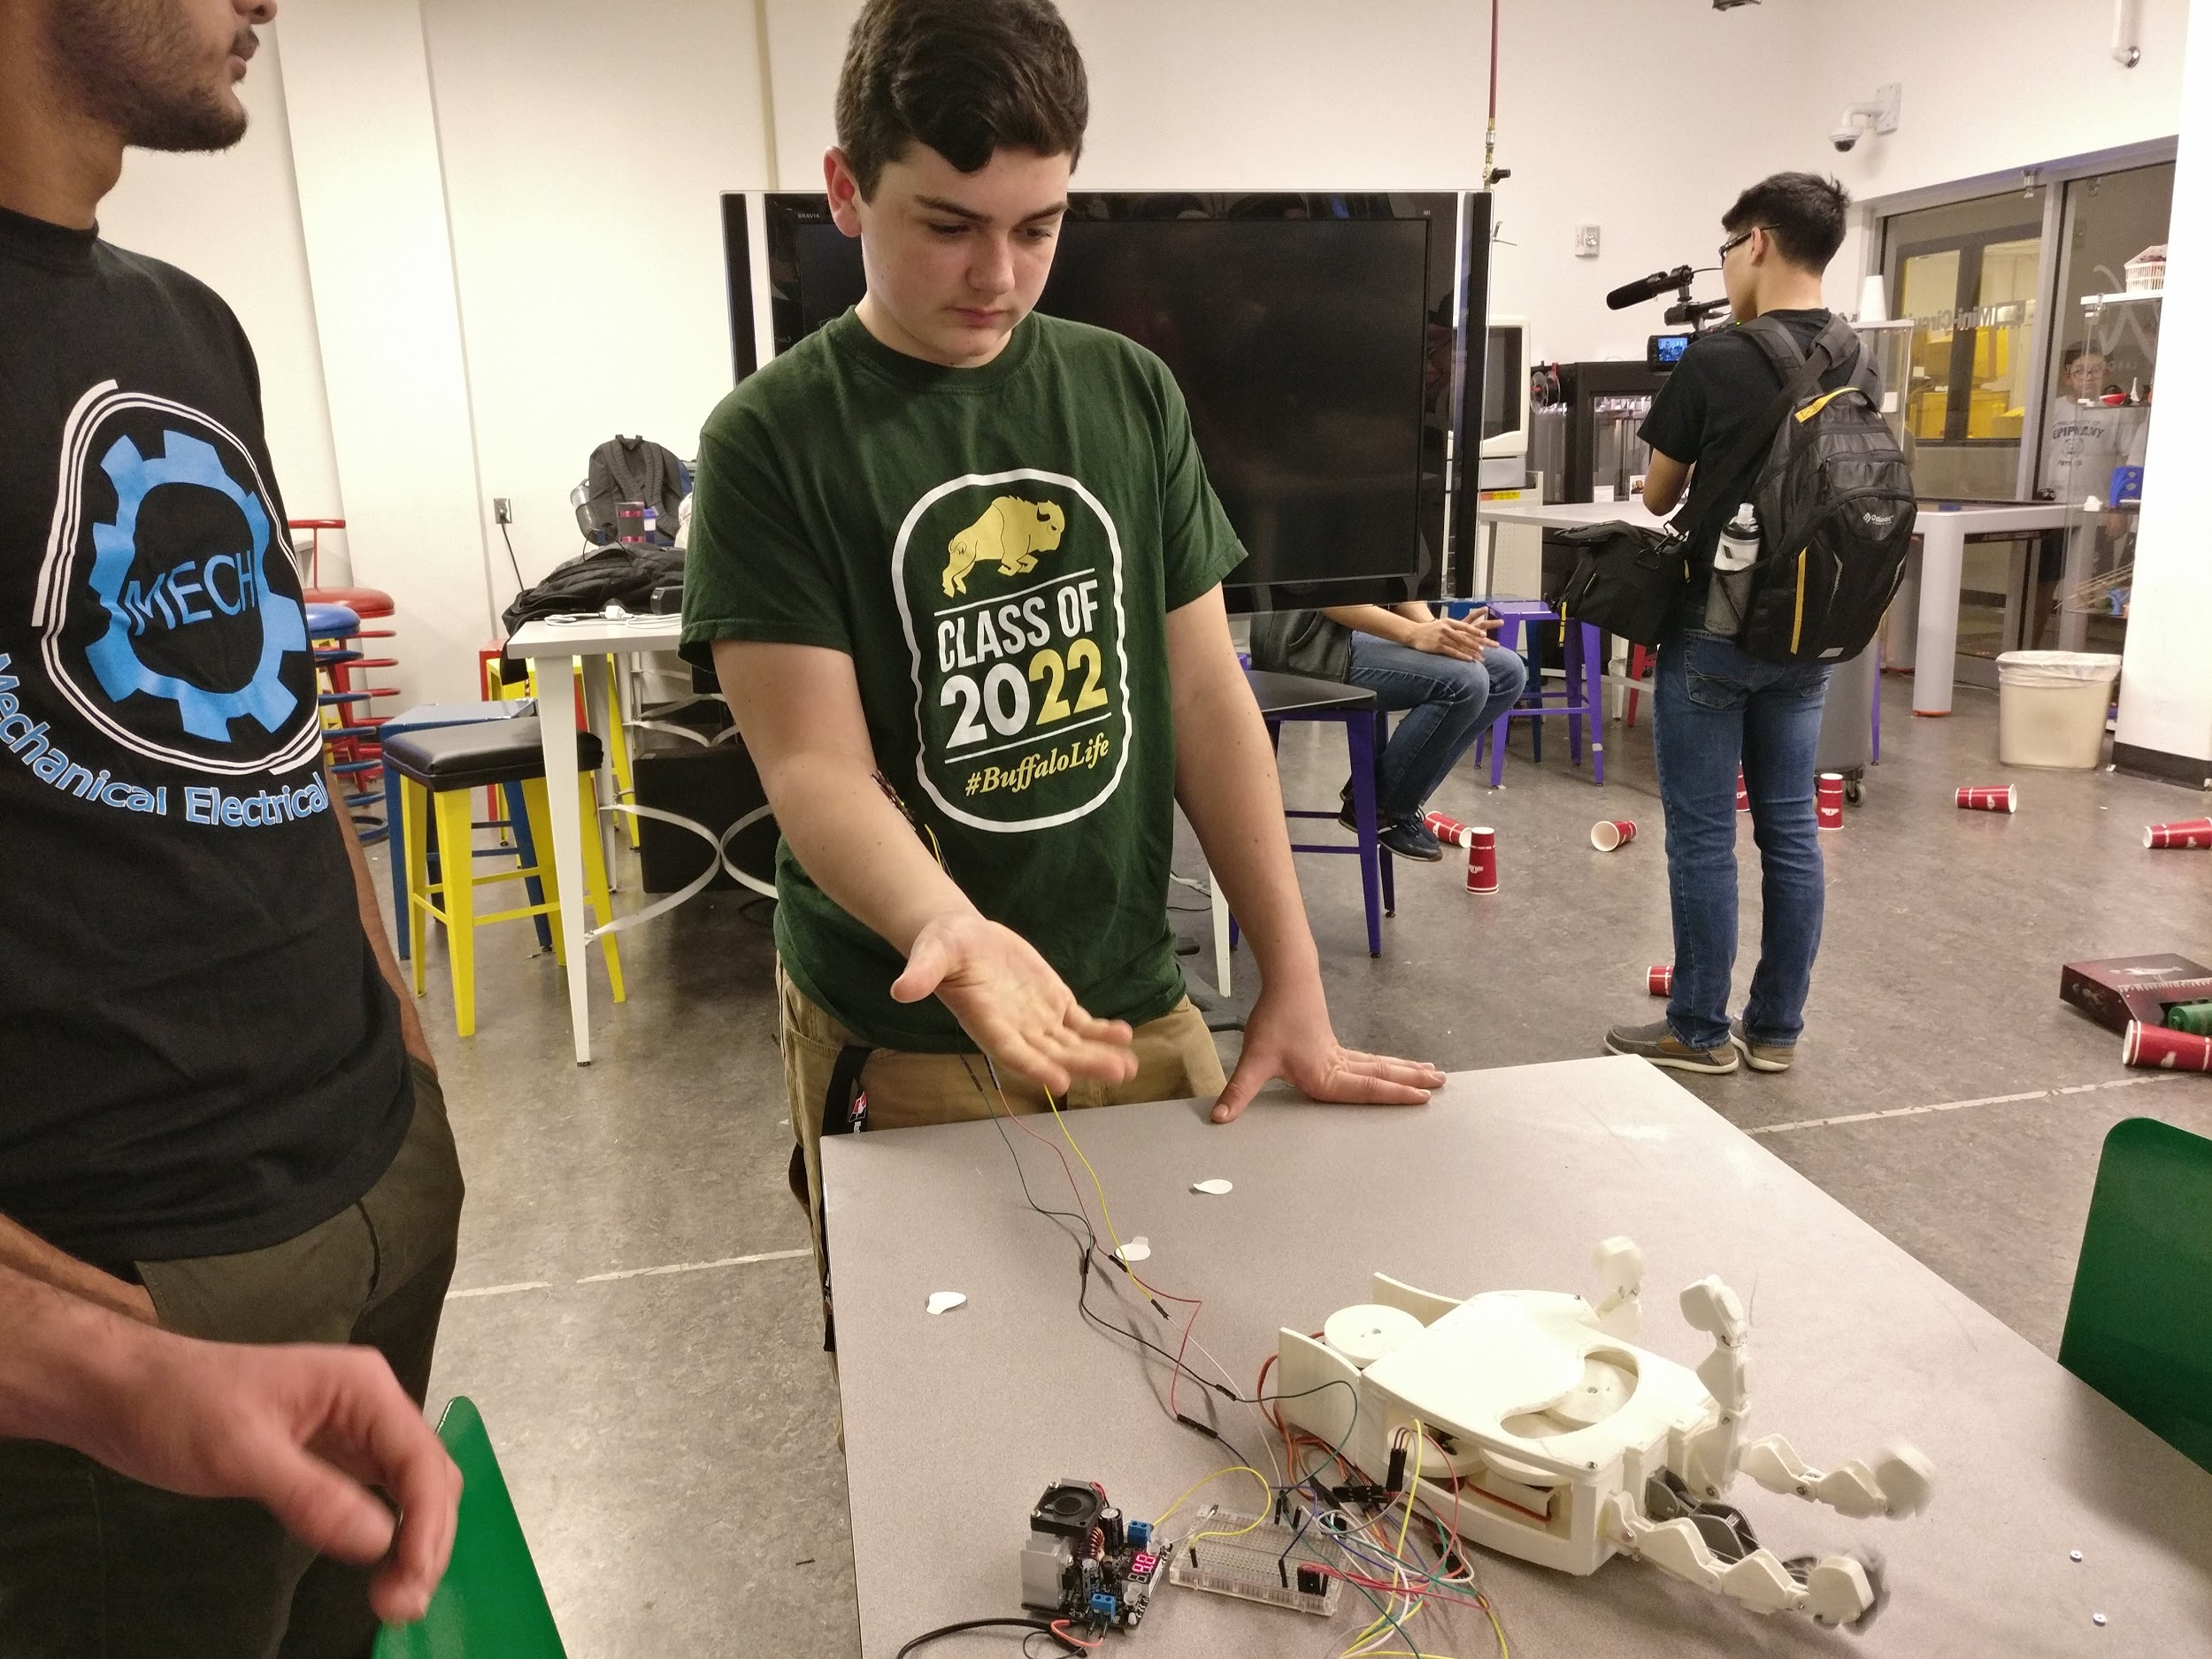
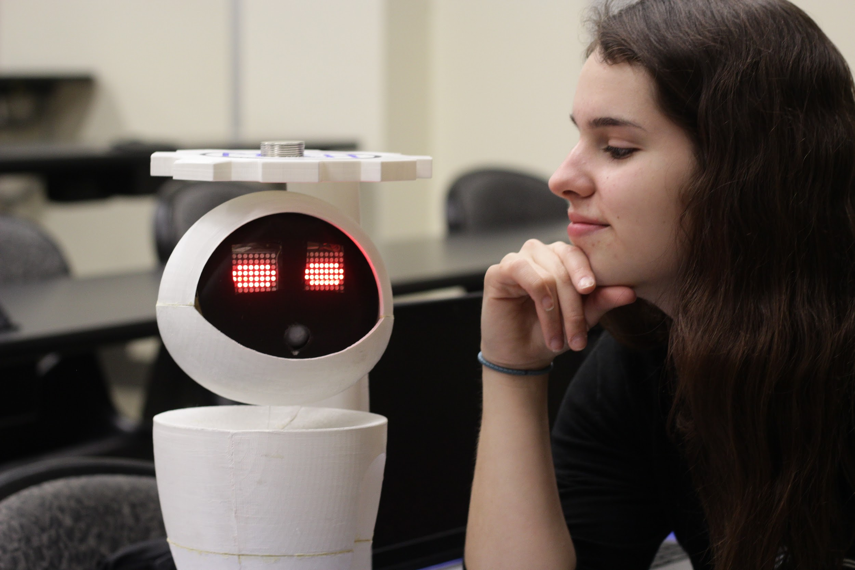
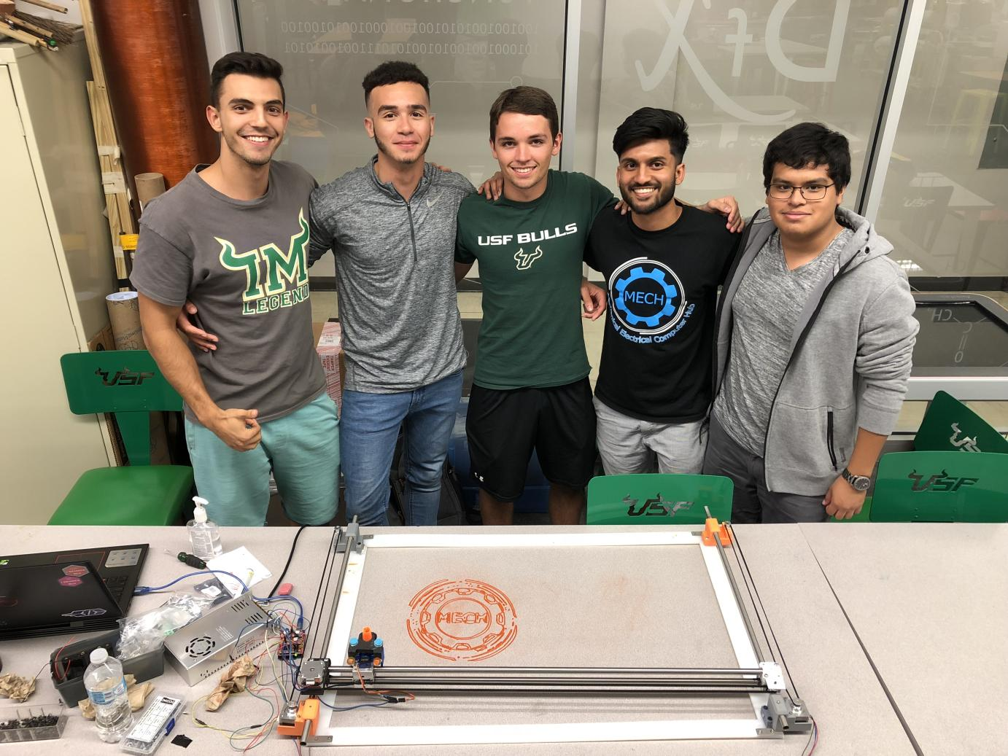
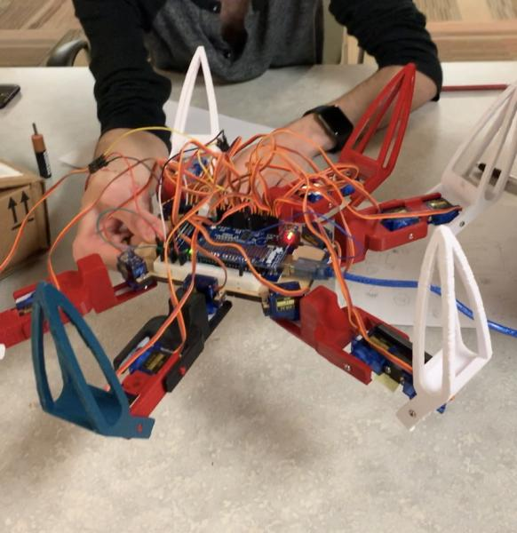
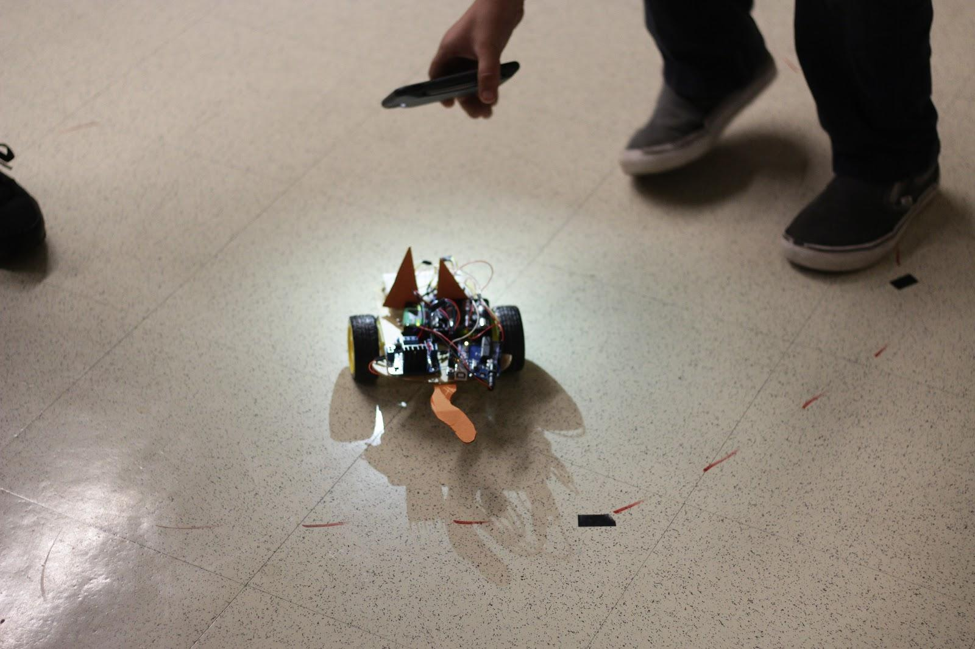
Projects
Your project here? 🤖

Slide 16


Project Ideas?
mechusf@gmail.com

Slide 17

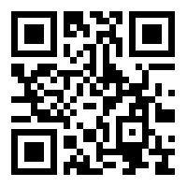

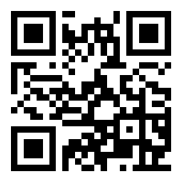

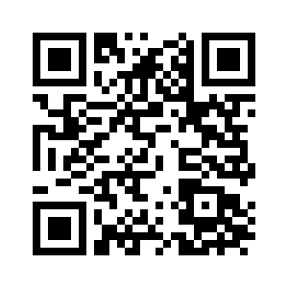

How Do I Join?
MECH USF
Mechanical Electrical Computer Hub

